Slide 1
1281 MOS_PFT
Template User Guide
Yuti Kadakia| DTP TCE2
Last updated – 07/17/2026

Slide 2
Template Capability
Purpose: To study the transistor characteristics in different configurations
Main Configurations:
Single Transistor
(NMOS, PMOS and CMOS)
Horizontal Matching
Vertical Matching
KKTCN
Multileg
Stacked
Multi-FIN
Features available for each configuration:
Active M0 Selection for all Vias
  Gate, SF, SS, DF, DS, TOPSOURCE,TAP
FTI Nesting and Roosting (Stacked FTI)
  Complete flexibility on FTI Placement
Diffusion Jogs and Depop
WF Island
Control on Poly Cuts (Poly Fill Effect) and Tcn Cuts
Full Control on position and density for VCR and VCRnub
FS (M1) Routing + Robust Mesh
Draw any Miscellaneous IDs
  Can be used for Drawing TAP or ID based skews

Slide 3
NOTE1: All track-based indexing starts from 0 unless specified otherwise or when used in indexing the jumper tracks for routing
NOTE2: Track-based indexing for PGD Tracks is from Left to Right
Track-based indexing for OGD Tracks is from Bottom to Top

Slide 4
INPUT PARAMETERS

Slide 5
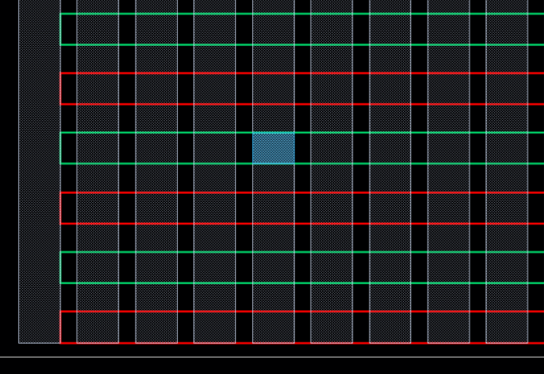
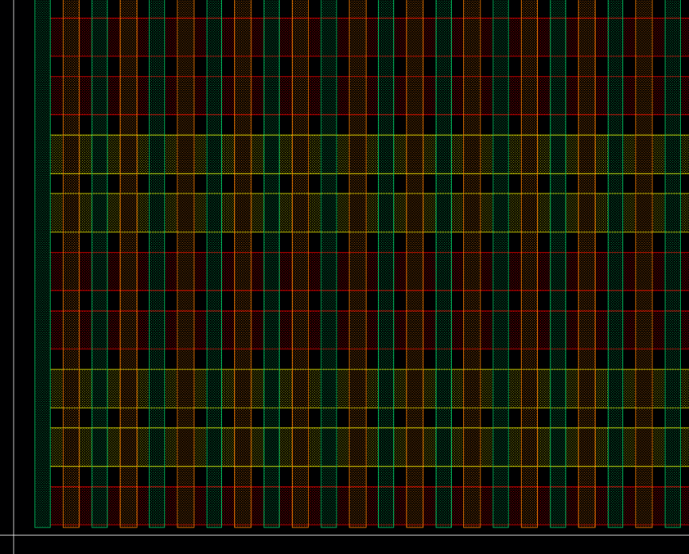
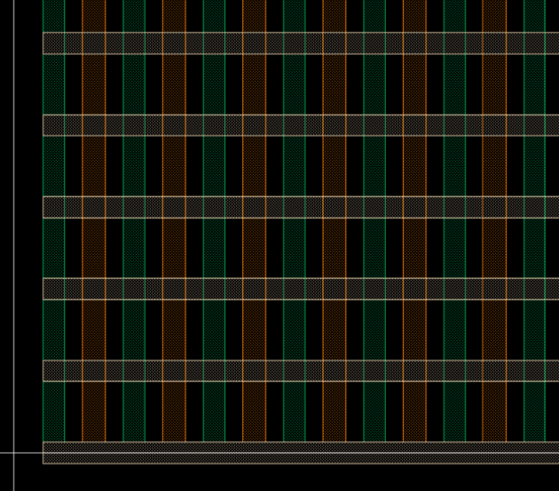
Track-based Indexing
0
1
2
3
4
5
6
7
M0; tccGuide1
0
1
2
3
4
5
6
7
8
9
10
4
M0; tccGuide2
0
1
2
3
4
5
6
7
8
9
10
11
3
7
2
6
1
5
0
4
0
1
2
3
4
5
Poly; tccGuide1
0
1
2
3
4
5
6
3
Tcn/Emr; tccGuide1
4
Poly/Tcn/Emr; tccGuide2
2
3
1
0
2
1
Poly; tccGuide1
Ndiff; tccGuide1
Tcn/Emr; tccGuide1
Pdiff; tccGuide1
0

Slide 6
Structure Definition:
cellHeight (string) → Cell height of the structure
  Example: “ch110”
polyPitch (string) → Poly pitch of the structure
  The skewed polyPitch will be enteres here to do the PolyCD/Pitch Skew
  Example: “pp44”
ContextType (string) → Context Type of the structure
  Options: “digital”, “custom” or blank
structureSize (string) → Size of the structure determined by defining the number of diffusions and poly tracks needed
  Format: Num Diffusion Tracks; Num Poly Tracks
  Example: 24;74
  The pattern in which FE is drawn, will always draw one extra poly tracks (Will be 75 tracks in total for the above example)

Slide 7
Metal Lego Definition:
M0LegoPattern (string) → M0 Lego Pattern Definition
  Format: cd;spc;cd;spc…
  Leaving it blank draws the default lego pattern for the specified cellHeight
  Guides drawn can be seen using m0;tccGuide1
M0CutLegoPattern (string) → M0 Cut Lego Pattern Definition
  This lego pattern is for the cut guides (can be seen using m0;tccGuide2) for M0 based on which the m0 cuts are placed
  Format: cd;spc;cd;spc…
  Leaving it blank draws the default cut lego pattern for the specified cellHeight
M1LegoPattern (string) → M1 Lego Pattern Definition
  Format: cd;spc;cd;spc…
  Leaving it blank draws the default lego pattern for the specified cellHeight
  Guides drawn can be seen using m1;tccGuide1
  NOTE: if using m1 guides for routing, the guides need to have the lego pattern as the router m1 (m1 Jumper pattern)

Slide 8
Diffusion Definition:
DiffLegoPattern (string) → Diffusion Pattern Definition
  Format1: diffPattern of starting tracks – active diffType – diffPattern for remaining tracks/DiffWidth [DiffWidth control is a new feature]
    Example: nnppnn – n – pppnnpp (OR) nnppnn – n – pppnnpp/0.02
    This format needs a complete lego pattern for all diffusion tracks in the structure
  Format2: diffPattern:RepeatValue/DiffWidth [Format2 is a new feature]
    Example: nnpp:4 (OR) nnpp:4/0.02
  DiffWidth is optional. Not giving that, will draw default diffusion size
DiffFTRSwitch (string) → Used to modify specific diffusions tracks to either size it or depop it
  This parameter can be used to create diffusion Jogs or depop a diffusion Track
  Format: tcnRange, diffRange, diffType / diffSize
  For depop, diffSize is 0
  tcnRange and diffRange can be either startRange : endRange (or) trackNumber
  Examples: 0:30,12,ndiff/0.032;40:73,12,ndiff/0.04;31:39,12,ndiff/0.03 (or) 0:74,12,ndiff/0

Slide 9
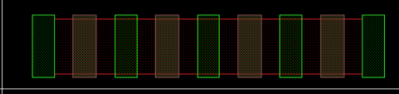
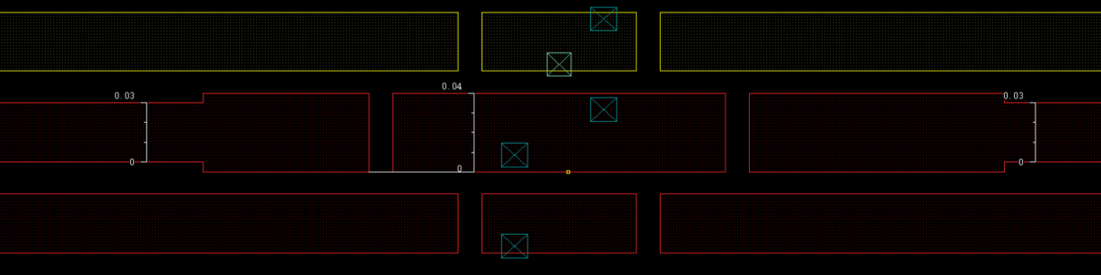
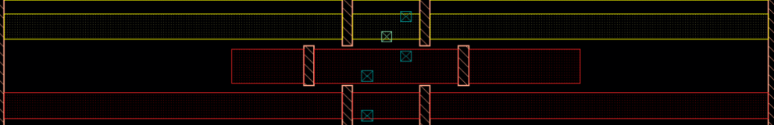
DiffFTRSwitch Examples
0
1
2
3
0:3,0,ndiff/0.03
0:30,12,ndiff/0.03; 31:39,12,ndiff/0.04; 40:73,12,ndiff/0.03
0:30,12,ndiff/0; 31:39,12,ndiff/0.04; 40:73,12,ndiff/0
0:73,2,ndiff/0

Slide 10
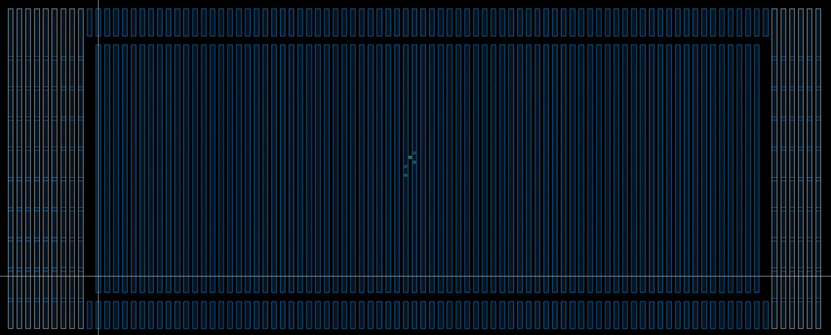
Via Parameters for all Pins:
DrawGATE (string) → Gate Via Patterns along with choosing the M1 Jumpers
  Format: Via Pattern (Poly Tracks, M0 Tracks) | L (or) R, M1 Jumper Tracks (OR)
  Via Pattern (Poly Tracks, M0 Tracks) | G, M1 Tracks (seen as m1;tccGuide1)
    Via Pattern format:
      X-Coordinate, Y-Coordinate [Skip Tracks – Optional] ,viaSizeX,viaSizeY-viaAlignment
      viaSizeX,viaSizeY & viaAlignment are optional parameters
      Multiple entries are separated by ;
    L or R corresponds to whether the left or right M1 jumpers are selected
    G corresponds to which m1 guide can be used for routing
    M1 Jumper Tracks on which the pin must be placed. The indexing starts from edges of the structure towards the outside. Indexing starts from 1
    For more than 1 transistor, multiple entries can be separated by /
9 8 7 6 5 4 3 2 1
1 2 3 4 5 6

Slide 11
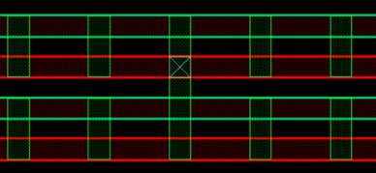
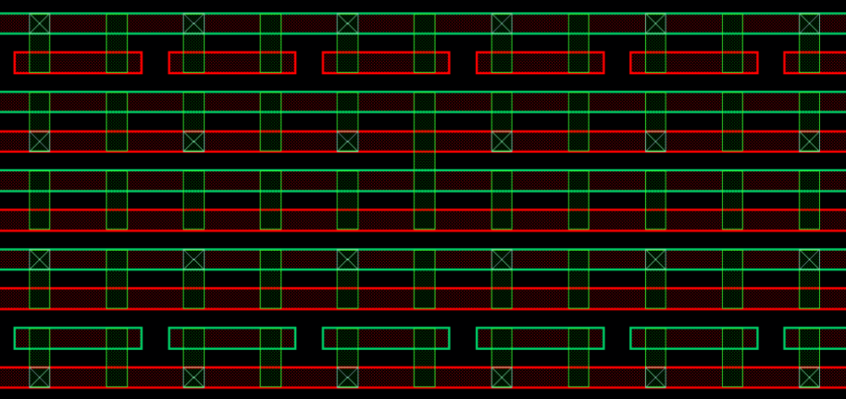
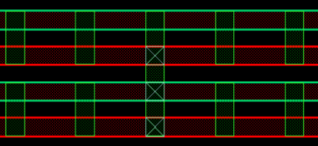
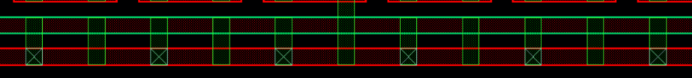
Via Pattern Examples→ Drawing Default Via Sizes
35,26|L,1:3
30:40[1],20:30[2]|L,1:3
35,24:26|L,1:3
30:40[1],26|L,1:3

Slide 12
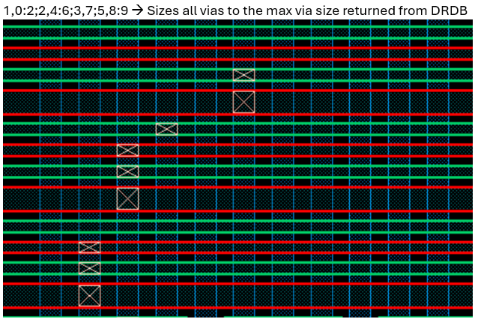
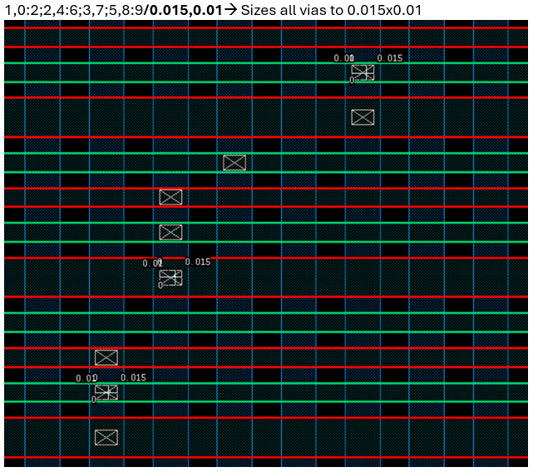
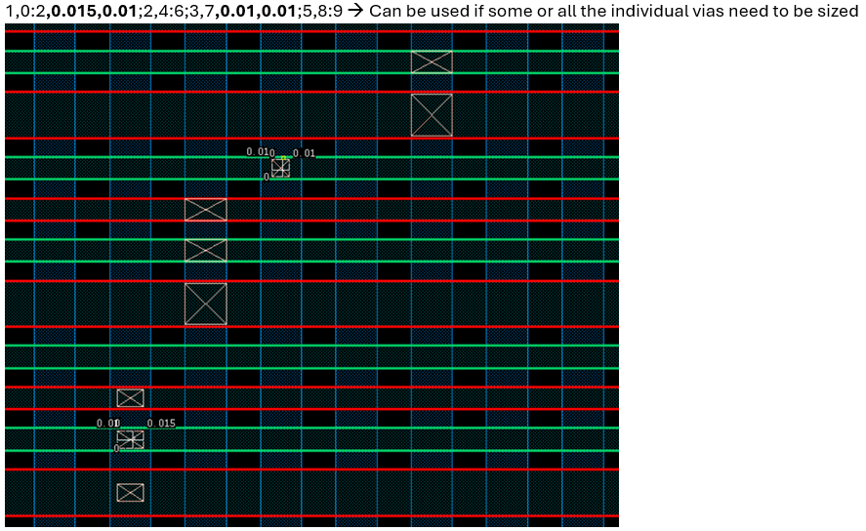
Additional Via Pattern Examples → For sizing vias (SDR ONLY)

Slide 13
Via Parameters for all Pins:
DrawSS (string) → SS Via Patterns along with choosing the M1 Jumpers
  Format: Via Pattern (Tcn Tracks, M0 Tracks) ~vcp/vcr (Optional) | L (or) R, M1 Jumper Tracks (OR) |G, M1 Tracks (seen as m1;tccGuide1),mesh
    Input after | is optional
    Mesh → draws a mesh upto highest metal layer (m2 in X81Z). Optional parameter
    Via Pattern format is same as drawGATE followed by ~vcp/vcr if viaLayer should be vcp/vcr instead of vt
    For more than 1 transistor, multiple entries can be separated by /
DrawSF (string) → SF Via Patterns along with choosing the M1 Jumpers (OR) |G, M1 Tracks (seen as m1;tccGuide1),mesh
  Format: Via Pattern (Tcn Tracks, M0 Tracks) ~vcp/vcr (Optional) | L (or) R, M1 Jumper Tracks
    Input after | is optional
    Via Pattern format is same as drawGATE followed by ~vcp/vcr if viaLayer should be vcp/vcr instead of vt
    For more than 1 transistor, multiple entries can be separated by /
DrawDS (string) → DS Via Patterns along with choosing the M1 Jumpers (OR) |G, M1 Tracks (seen as m1;tccGuide1),mesh
  Format: Via Pattern (Tcn Tracks, M0 Tracks) ~vcp/vcr (Optional) | L (or) R, M1 Jumper Tracks
    Via Pattern format is same as drawGATE followed by ~vcp/vcr if viaLayer should be vcp/vcr instead of vt
    For more than 1 transistor, multiple entries can be separated by /
DrawDF (string) → DF Via Patterns along with choosing the M1 Jumpers (OR) |G, M1 Tracks (seen as m1;tccGuide1),mesh
  Format: Via Pattern (Tcn Tracks, M0 Tracks) ~vcp/vcr (Optional) | L (or) R, M1 Jumper Tracks
    Via Pattern format is same as drawGATE followed by ~vcp/vcr if viaLayer should be vcp/vcr instead of vt
    For more than 1 transistor, multiple entries can be separated by /
DrawTOPSOURCE(string) → TOPSOURCE Via Patterns along with choosing the M1 Jumpers
  Format: Via Pattern (Tcn Tracks, M0 Tracks) | L (or) R, M1 Jumper Tracks
    Via Pattern format is same as drawGATE
    For more than 1 transistor, multiple entries can be separated by /
DrawTAP (string) → TAP Via Patterns along with choosing the M1 Jumpers
  Format: Via Pattern (Tcn Tracks, M0 Tracks) ~vcr (Optional) | L (or) R, M1 Jumper Tracks
    Input after | is optional
    Via Pattern format is same as drawGATE followed by ~vcr if viaLayer should be vcr instead of vt
    For more than 1 transistor, multiple entries can be separated by /

Slide 14
Pin Directions:
PinDirection (string) → Determine the direction (N or S) in which the pin should be placed
  Format: PinName : direction (N or S)
  Multiple entries can be separated by ;
Pin Name Convention → PinName followed by the pin number
For 1st Transistor: GATE1, SF1, SS1, SS_BS1, SF_BS1, DS1, DF1, TOPSOURCE1
For 2nd Transistor: GATE2, SF2, SS2, SS_BS2, SF_BS2, DS2, DF2, TOPSOURCE2
If one transistor wants to use 2 DF pins, then pin names will still be DF1 and DF2
Pin number and transistor number have no association to each other

Slide 15
Cut & Dummy Via Parameters:
M0CutPattern (string) → Determine the M0 Cut Pattern
  Format: Cut Pattern (M0 Cut Guides, M0 Guides)
    X-Coordinate, Y-Coordinate|cutsize,cutMisreg
    X-coordinate is m0;tccGuide2 (the cutguide track num) and Y-coordinate is m0;tccGuide1 (the guide track num)
    Both X and Y can either be a single value or a range of values (start:end) and [Skip Tracks are optional]
    CutSize and CutMisreg are optional parameters
    Multiple entries are separated by ;
M1CutPattern (string) → Determine the M1 Cut Pattern
  Format: Cut Pattern (M1 Guides, M1 Cut Guides)
    X-Coordinate, Y-Coordinate|cutsize,cutMisreg
    X-coordinate is m1;tccGuide1 (the guide track num) and Y-coordinate is m1;tccGuide2 (the cut guide track num)
    Both X and Y can either be a single value or a range of values (start:end) and [Skip Tracks are optional]
    CutSize and CutMisreg are optional parameters
    Multiple entries are separated by ;
DummyViaPattern (string) → Determine the Dummy Via Pattern (V0)
  Format: Via Pattern (PgdLay Guides, OgdLay Guides)
    X-Coordinate, Y-Coordinate, viaSizeX,viaSizeY - viaAlignment
    Both X and Y can either be a single value or a range of values (start:end) and [Skip Tracks are optional]
    viaSizeX,viaSizeY & viaAlignment are optional parameters
    Multiple entries are separated by ;

Slide 16
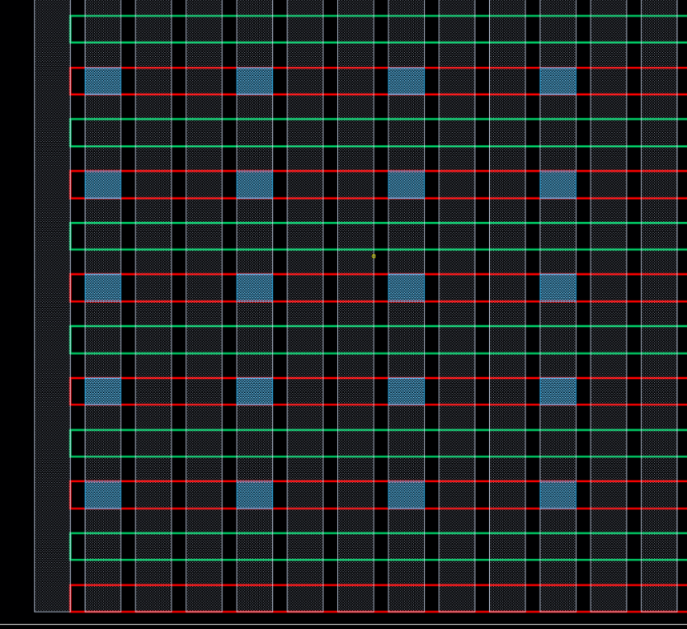
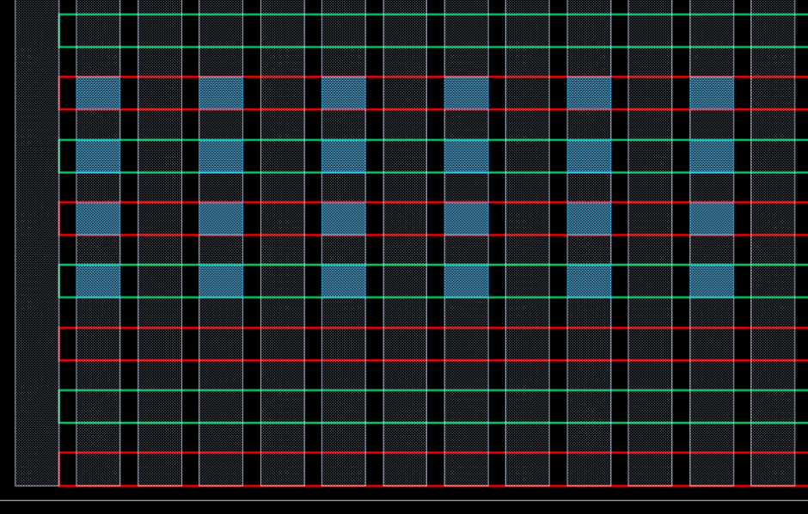
Cut Pattern Examples
Since, the first cutguide is not interacting with the M0 Guides, the 1st cut guide from where the indexing starts will be the cutguide which interacts with the m0 guides.
As per the example on the left, the 2nd cutguide will start it’s indexing from 0
4
3
2
1
0
1
2
3
0
3,3
0:10[1],3:6
0:10[2],2:10[1]

Slide 17
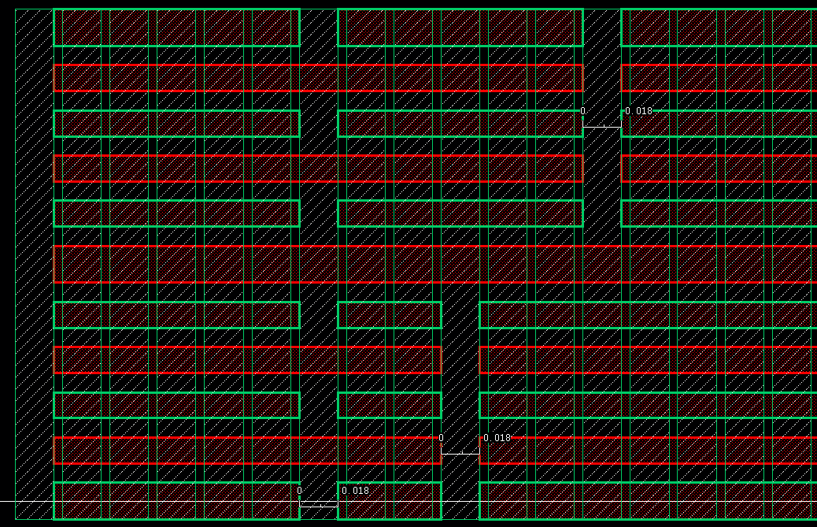
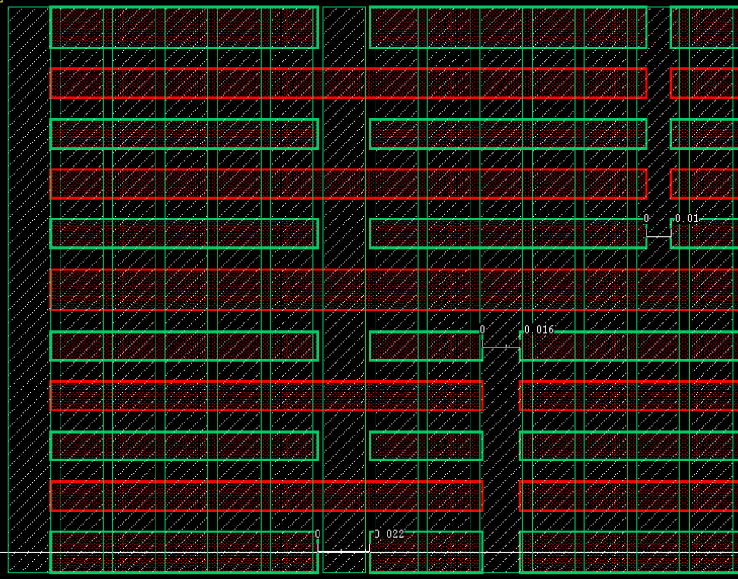
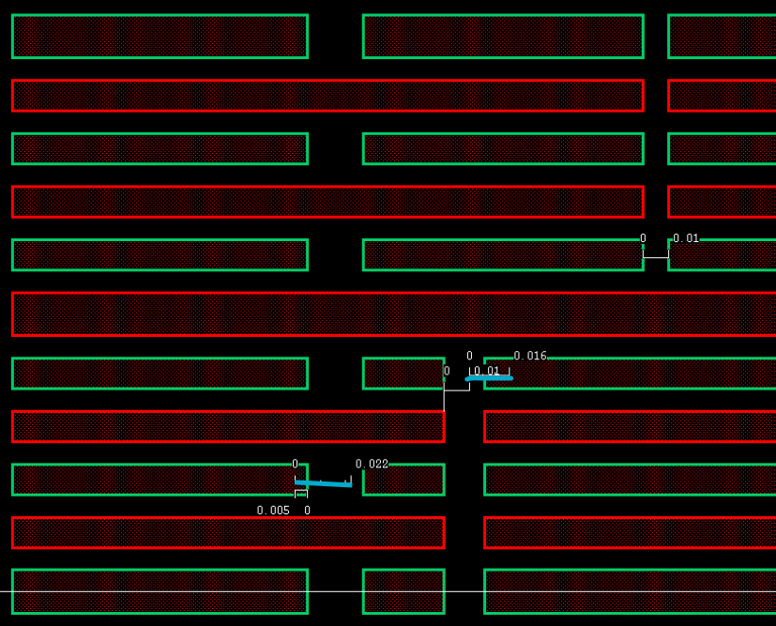
Additional Cut Pattern Examples
5,0:10[1];8,0:4;11,6:10
5,0:10[1]|0.022;8,0:4|0.016;11,6:10|0.01
5,0:10[1]|0.022,0.005;8,0:4|0.016,-0.01;11,6:10|0.01 (Blue shows original placement and what is marked below it is the misreg amount)

Slide 18
Matrix Parameters:
FtiMatrix (string) → Determine the FTI Pattern around a reference point using a matrix style input
  Format: Poly Ref Track,Diff Ref Track; MatrixSize X,MatrixSize Y; FTI Pattern
      Matrix Size in X and Y should always be an odd number
      1 → Draw FTI, 0 → No FTI
      Multiple entries are separated by /

Slide 19
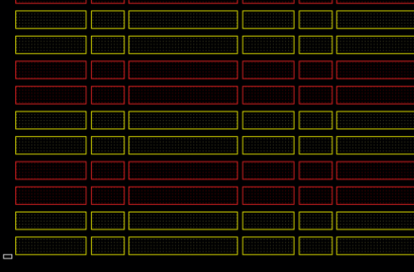
CRL
9
DKA
8
CRL
7
DKA
6
CRL
5
DKA
4
CRL
3
DKA
2
CRL
1
DKA
0
CRL

Slide 20

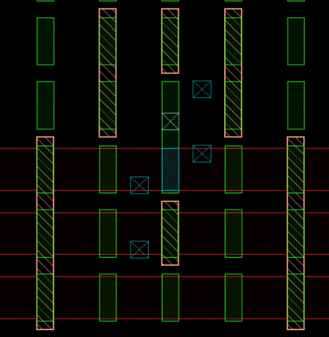
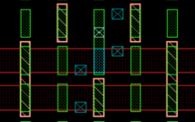
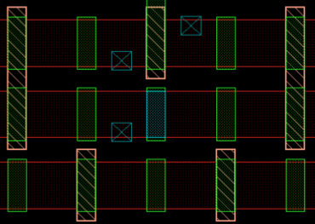
FtiMatrix Examples
NEST
35,12;5,1;NEST:10-0-01
ROOST_DKA1
ROOST_DKA0
NEST
ROOST_DKA0
ROOST_CRL0
35,12;5,3; NEST:10-0-01, ROOST_CRL0:10-1-01,
ROOST_DKA0:01-0-10
NEST
ROOST_CRL0
ROOST_CRL0
NEST
ROOST_CRL1
ROOST_DKA0
35,12;5,5;NEST:10-0-01,
ROOST_CRL0:10-1-01,ROOST_DKA0:01-0-10,
ROOST_CRL1:10-0-01,ROOST_DKA1:01-1-10
35,11;5,3; NEST:10-0-01, ROOST_CRL0:10-1-01,
ROOST_DKA0:01-0-10

Slide 21
PolyMatrix (string) → Determine the locations to remove Poly Cuts around a reference point using a matrix style input
  Format: Poly Ref Track,Diff Ref Track; MatrixSize X,MatrixSize Y; Remove Poly Cut Pattern
      Matrix Size in X and Y should always be an odd number
      1 → Remove Cut, 0 → Preserve Cut
      Multiple entries are separated by /

Slide 22
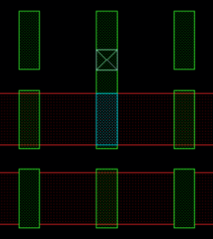
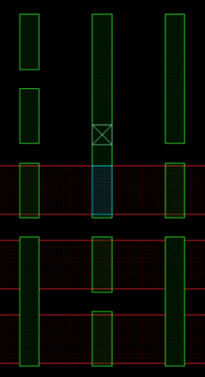
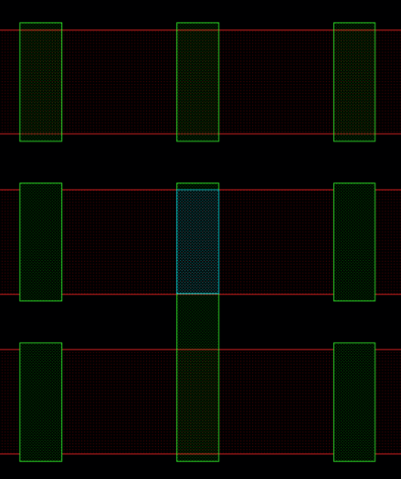
PolyMatrix Examples
DKA0
0
1
0
CRL0
0
0
0
DKA1
0
1
1
35,12;3,3;CRL0:0-0-0, DKA0:0-1-0
DKA0
0
1
0
CRL0
0
0
0
CRL0
0
0
0
CRL1
1
0
1
DKA0
0
1
0
35,12;3,5;CRL0:0-0-0, DKA0:0-1-0,
CRL1:1-0-1, DKA1:0-1-1
35,11;3,3;CRL0:0-0-0, DKA0:0-1-0

Slide 23
TcnMatrix (string) → Determine the locations to remove Tcn Cuts around a reference point using a matrix style input
  Format: Poly Ref Track,Diff Ref Track; MatrixSize X,MatrixSize Y; Remove Tcn Cut Pattern
      Matrix Size in X and Y should always be an odd number
      1 → Remove Cut, 0 → Preserve Cut
      Multiple entries are separated by /

Slide 24
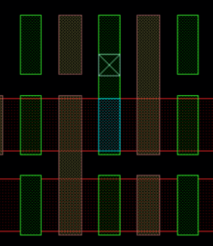
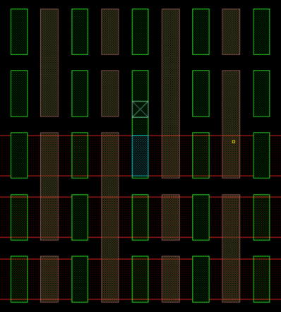
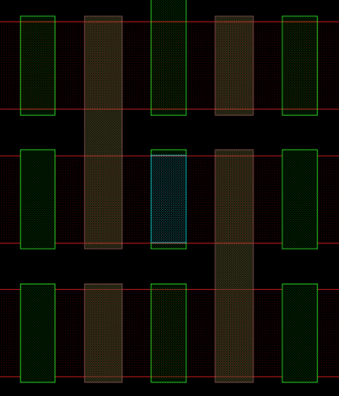
TcnMatrix Examples
DKA0
0
1
CRL0
1
0
DKA1
1
0
1
0
35,12;3,3;CRL0:1-0, DKA0:0-1
0
DKA0
0
1
1
CRL0
CRL0
1
1
0
0
1
0
CRL1
0
1
0
1
DKA0
0
1
35,12;5,5;CRL0:11-00, DKA0:00-11, CRL1:01-01, DKA1:10-10
35,11;3,3;CRL0:1-0, DKA0:0-1

Slide 25
Multi FIN Parameters: [New feature]
HorizontalPFTsConfig (string) → Determine how many horizontal PFTs should be drawn
  Format: Number of horizontal PFTs,Distance
      Distance → Distance between gates of horizontal PFT as number of poly tracks
      Entries for each PFT can be separated by /
        Matching structures would need 2 entries, one for each of the PFT in the matching pair
        Example: 2,15/2,15
VerticalPFTsConfig (string) → Determine how many vertical PFTs should be drawn
  Format: Number of vertical PFTs, Distance1,Distance2
      Distance1 → Distance between vertical PFT as number of diffusion tracks
        Needed to repeat all the matrices
      Distance2 → Distance between vertical PFT gate vias as number of m0 tracks
        Needed to repeat all the Vias
      Entries for each PFT can be separated by /
PLEASE NOTE:SS and DS vias are not repeated currently

Slide 26
Non-Matrix Parameters:
FTITracks (string) → Draw FTI over the entire structure except the FTI Matrix
  Format: FTI Tracks, Diffusion Tracks
      FTI Tracks can be a range (start : end), a single value or multiple tracks separated by / as long as the length of those FTIs are the same (Same Diffusion Range)
      Diffusion Tracks can be a range (start : end) or a single value
      Multiple entries are separated by ;
      Examples:
        0,0:10; 5,5
        0:1,0:10; 5:7[1],0:10; 15:25[2],7
        0/3/7/12/17,0:10; 5/8/13/15,2

Slide 27
DrawFECuts (string) → Locations on which the TCN and Poly Cuts need to be placed [outside the matrix]
  Format: Tcn (or) Poly Guide Tracks, Tcn (or) Poly Cut Guide Tracks – poly (or) tcn [X,Y – poly (or) tcn]|cutSize,cutMisreg
      Both X and Y Coordinates can be a range (start : end) or a single value
      Skip Tracks for both X-Coordinate and Y-Coordinate is Optional
      CutSize and CutMisreg are optional parameters too
      Multiple entries are separated by ;
      Example: 1,1-poly; 5:10,3:10[1]-tcn; 3,6:8-poly
MergeFECuts (string) → Locations on which the TCN and Poly Cuts need to be removed [outside the matrix]
  Format: Tcn (or) Poly Guide Tracks, Tcn (or) Poly Cut Guide Tracks – poly (or) tcn [X,Y – poly (or) tcn]
      Both X and Y Coordinates can be a range (start : end) or a single value
      Skip Tracks for both X-Coordinate and Y-Coordinate is Optional
      Multiple entries are separated by ;
      Example: 1,1-poly; 5:10,3:10[1]-tcn; 3,6:8-poly
TcnDepop (string) → Determine the locations to depop TCN
  Format: allEMR;locations to depop extra TCN/locations within allEMR where no tcn depop should occur
      allEMR removes tcn from all locations where EMR is present
      Locations are X,Y where X are TCN Guide Tracks and Y are Diffusion Guide Tracks
      Both X and Y Coordinates can be a range (start : end) or a single value
      Skip Tracks for both X-Coordinate and Y-Coordinate is Optional
      Multiple entries are separated by ;
      Leaving it blank does not depop any TCN

Slide 28
VcrPattern (string) → Determine the locations to place vcr
  Format: Vcr Guide Tracks, Tcn Reference Tracks followed by skew inputs (optional)
  Skew Format: x1,y1|grow1X,grow1Y,misreg1X,misreg1Y; x2,y2|grow2X,grow2Y,misreg2X,misreg2Y (OR) x1,y1;x2,y2;x3,y3/growX,growY,misregX,misregY
  X coordinate are vcr Guides (seen as vcr;tccGuide1)
  Y coordinate are tcn reference tracks (seen as vcr;tccGuide2)
  Both X and Y Coordinates can be a range (start : end) or a single value
  Skip Tracks for both X-Coordinate and Y-Coordinate is Optional
  Multiple entries are separated by ;
  Grow and Misreg parameters are optional
VcrnubPattern (string) → Determine the locations to place vcrnub
  Format: Vcr Guide Tracks, Tcn Reference Tracks, Vcrnub Direction followed by skew inputs (optional)
  Skew Format: x1,y1,top|grow1X,grow1Y,misreg1X,misreg1Y; x2,y2,bottom|grow2X,grow2Y,misreg2X,misreg2Y (OR) x1,y1,top;x2,y2,bottom;x3,y3,both/growX,growY,misregX,misregY
  X coordinate are vcr Guides (seen as vcr;tccGuide1)
  Y coordinate are tcn reference tracks (seen as vcr;tccGuide2)
  Both X and Y Coordinates can be a range (start : end) or a single value
  Skip Tracks for both X-Coordinate and Y-Coordinate is Optional
  Multiple entries are separated by ;
  Grow and Misreg parameters are optional

Slide 29
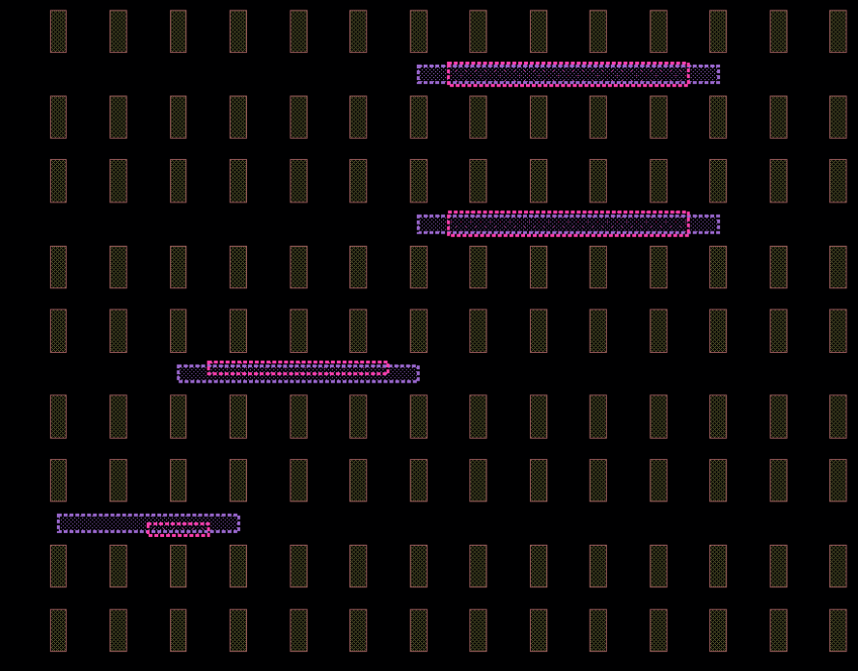
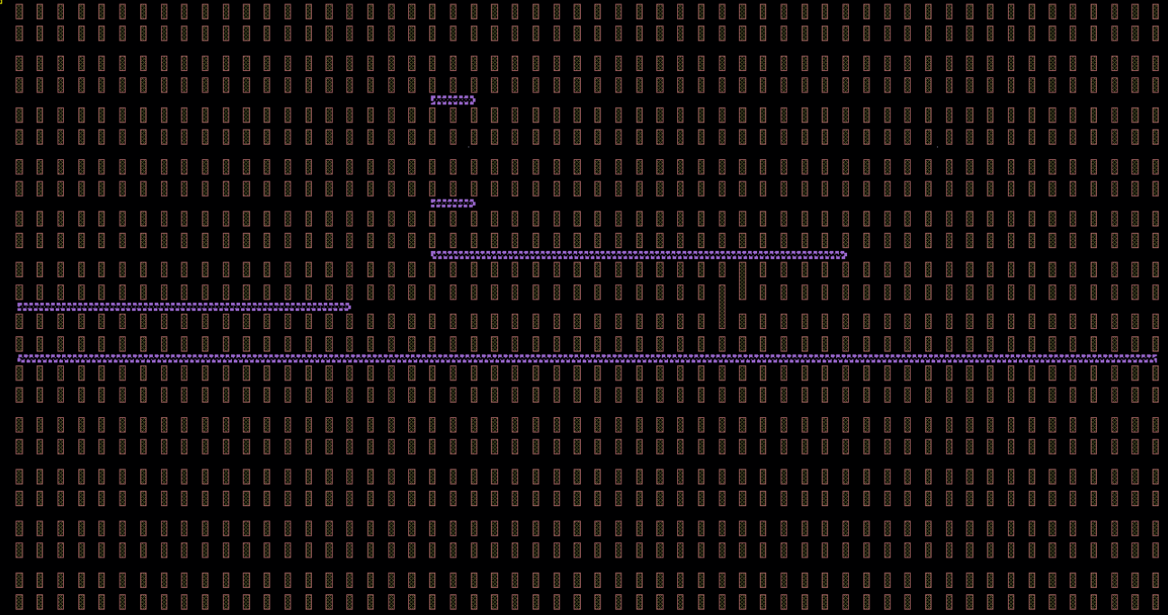
SDR Vcr and Vcrnub Examples
vcrPattern → 0:16,6;20:40,7;20:22,8:10[1];0:r0,5 (brown → tcn, purple → vcr)
vcrPattern → 2:6,2;0:3,1;6:11,3:4 (purple → vcr)
vcrnubPattern → 3:5,2,top;2,1,bottom;7:10,3:4,both (pink → vcrnub)

Slide 30
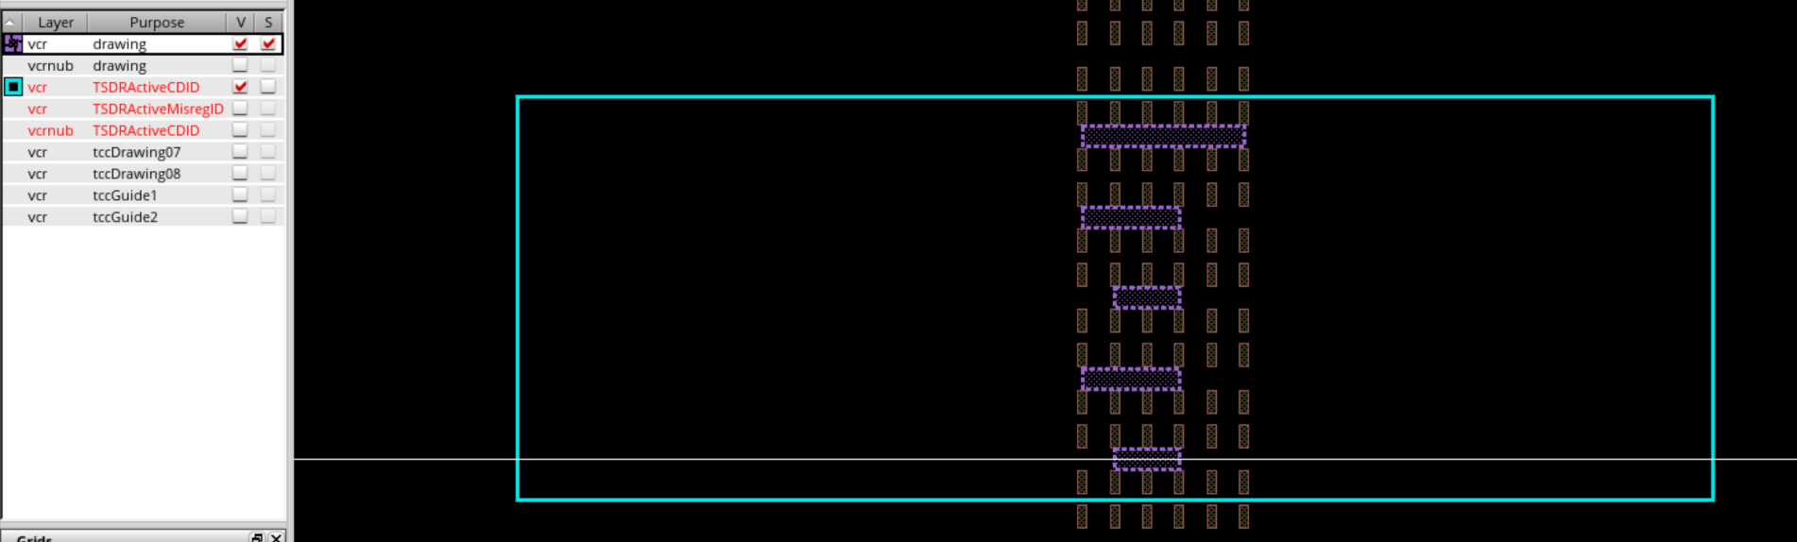
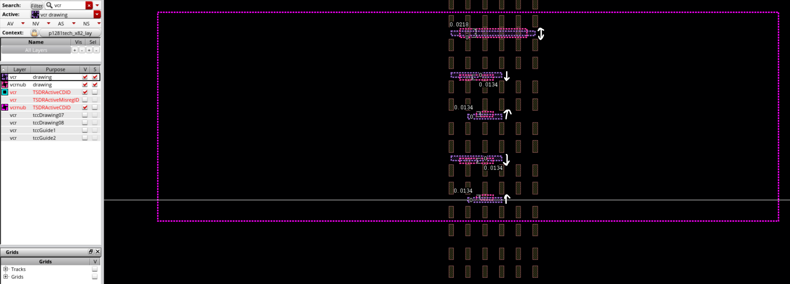
Vcr and Vcrnub Skew Examples
vcrPattern → 1:3,2:4[1];0:3,3:5[1];0:r0,6/0,0.016,0,0
(brown → tcn, purple → vcr)
vcrPattern → 1:3,2:4[1];0:3,3:5[1];0:r0,6 (purple → vcr)
vcrnubPattern → 2,2:4[1],top;1:2,3:5[1],bottom;1:4,6,both/0,0.005,0,0 (pink → vcrnub)
Arrows indicate direction of CD and Misreg skews (For top and bottom nubs, they move towards/away from DKA with one edge always aligning at CRL)

Slide 31
TcnExtension (string) → Determine the locations where tcn should be extended into CRL
  Format: “allvcrnub” (OR) Vcr Guide Tracks, Tcn Reference Tracks
      “allvcrnub” would extend all the tcns facing the vcrnub.
      Using specific coordinate patterns allows only specific tcns to be extended into CRL which are facing the vrcnub
      Both X and Y Coordinates can be a range (start : end) or a single value
      Skip Tracks for both X-Coordinate and Y-Coordinate is Optional
      Multiple entries are separated by ;
      Example: 0:r0,2:4;1:4[1],5:8

Slide 32
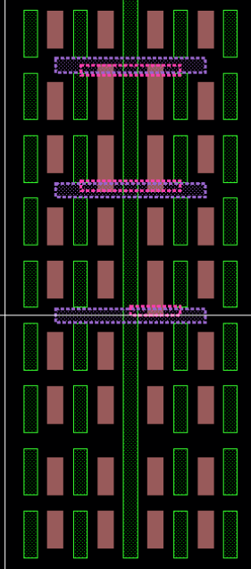
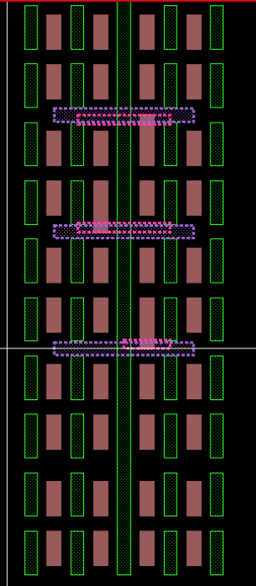
Tcn Extension Examples
vcrPattern → 0:r0,2:4
vcrnubPattern → 2,2,top;1:2,3,top;1:2,4,bottom
tcnExtension → “allvcrnubs”
vcrPattern → 0:r0,2:4
vcrnubPattern → 2,2,top;1:2,3,top;1:2,4,bottom
tcnExtension → 2,2;1,3;2,4

Slide 33
Miscellaneous:
DrawDevFlav (string) → Draw DevFlav IDs
  Format: purpose, tcnRange, diffRange, growLeft, growBottom, growRight, growTop[last 4 are optional]
  tcnRange and diffRange can be either startRange : endRange (or) trackNumber
  LPPs are case-sensitive. Multiple LPPs can be separated by a semi-colon
StructureDevFlav (string) → Determine devflav for tracks not needed track based control [New feature]
  Format: devFlav id (lvt, svt, ulvt etc.)
  The main purpose of this input is to avoid having to give devflav ID needed for each track
  Another purpose is if the entire structure is the same devflav type, just mentioning the number should suffive and DrawDevFlav can be left blank
DrawMiscIDs (string) → Add any additional IDs in the structure
  Format: layer: purpose, polyRange, diffRange| growLeft, growBottom, growRight, growTop
  polyRange and diffRange can be either startRange : endRange (or) trackNumber
  Grow parameters are optional
  LPPs are case-sensitive. Multiple LPPs can be separated by a semi-colon
DeleteLpps (string) → Delete specified LPPs from the structure
  Format: layer1:purpose1; layer2:purpose2
  LPPs are case-sensitive. Multiple LPPs can be separated by ;

Slide 34
TSDR Skews 2 (ENABLED):
IdLayerBasedSkew (string) → Determine the ID layer based skew type. Based on skew name, respective TSDRID will be drawn
  Direct Poly Print Skews can be exercised with the format → poly:TSDRn1 or poly:TSDRp16A
PolyCdSkew (string) → Poly Pitch/ PolyCD Skew
  Format: polyPitch;PolyCd;TcnCd
FTICdMisregSkew (string) → FTI CD and REG Skew
  Format: FTIGrowOgd,FTIGrowPgd,FTIMisregOgd,FTIMisregPgd,Y or N to draw TSDRNoDepop
PXLSkew (string) → PXL CD and REG Skew
  Format: PXLCd, PXL_Misreg_pgd, trmShpsToSkew
  Options for trmShps are all, crl, dka
GLKSkew (string) → GLK CD and REG Skew
  Format: GLKGrowOgd,GLKGrowPgd,GLKMisregOgd,GLKMisregPgd
TCPSkew (string) → TCP CD and Misreg Skew
  Skews Tcn plugs
  Format: all OR Tcn Guide Num,Tcn CutGuide Num (both can be a single value or a range of tracks) followed by growOgd,growPgd,misregOgd,misregPgd
    “all” skews all the tcn plus using TCP_mask
    If only specific plugs need to be skewed, provide the coordinate locations. Rest will have SDR TCP_mask drawn
  Example: all|0,0,0.005,0 (OR) 0:r0,8:12|0,0.005,0,0
TcnCdRegSkew (string) → TCN CD and REG Skew
  Format: TCNGrowOgd,TCNGrowPgd,TCNMisregOgd,TCNMisregPgd
  Skew is drawn using TCG_mask

Slide 35
TSDR Skews 1 (These are not enabled for X81Z yet):
SFTSkew (string) → Forksheet Skew
  Format: dprCd,flcCd,spineCd,switchFlcToPxl (Y or N) [CD for DPR_mask, FLC_mask and Spine followed by Y or N to replace the FLC_mask by PXL_mask]
  Spine will not be drawn as a physical layer (We need it for determining the space between DPR_mask)
  The rest of the masks (PXL, GLK, TLK) will be automatically drawn
TallCellSkew (string) → TallCell Skew
  Format: dprCd,wideDprCd [CD for Regular DPR_mask and Wide DPR_mask]
  The rest of the masks (PXL, GLK, TLK) will be automatically drawn
DPRSkew (string) → DPR CD and Misreg Skew
  Format: DprCd,DprMisreg

Slide 36
Miscellaneous:
kernelOffsetX (float) → Amount by which structure moves on X-axis
kernelOffsetY (float) → Amount by which structure moves on Y-axis
Grid Values:
CHPP Combo | GridX | GridY
CH110PP44 | 0.176 | 0.66
CH132PP44 | 0.176 | 0.264
CH165PP44 | 0.176 | 0.33

Slide 37
Row Reference:
Pending for PFT scratch4x81rb_x82_lay → x81rbs_yk_vcr_skews scratch4x81rb_x82_lay → x81rbs_yk_tc_skews

